Slide 1

{{TITLE}}
{{DESCRIPTION}}
Notes:
--- This slide focuses on articulating the product’s core purpose and unique value that addresses a real problem or need in the market. Image source: Microsoft 365 content library

Slide 2

[TITLE]
[SYNOPSIS]
Notes:
--- Describes how the product is positioned uniquely to capture market share and address unmet needs. Image source: Microsoft 365 content library

Slide 3
{{TITLE}}
{{DESCRIPTION}}
Notes:
--- This slide focuses on articulating the product’s core purpose and unique value that addresses a real problem or need in the market. Image source: Microsoft 365 content library

Slide 4

{{TITLE}}
{{DESCRIPTION}}
Notes:
--- This slide focuses on articulating the product’s core purpose and unique value that addresses a real problem or need in the market. Image source: Microsoft 365 content library

Slide 5

{{TITLE}}
{{DESCRIPTION}}
Notes:
--- This slide focuses on articulating the product’s core purpose and unique value that addresses a real problem or need in the market. Image source: Microsoft 365 content library

Slide 6

[TITLE]
[SYNOPSIS]
Notes:
--- Describes how the product is positioned uniquely to capture market share and address unmet needs. Image source: Microsoft 365 content library

Slide 7

{{TITLE}}
{{DESCRIPTION}}
Notes:
--- This slide focuses on articulating the product’s core purpose and unique value that addresses a real problem or need in the market. Image source: Microsoft 365 content library

Slide 8
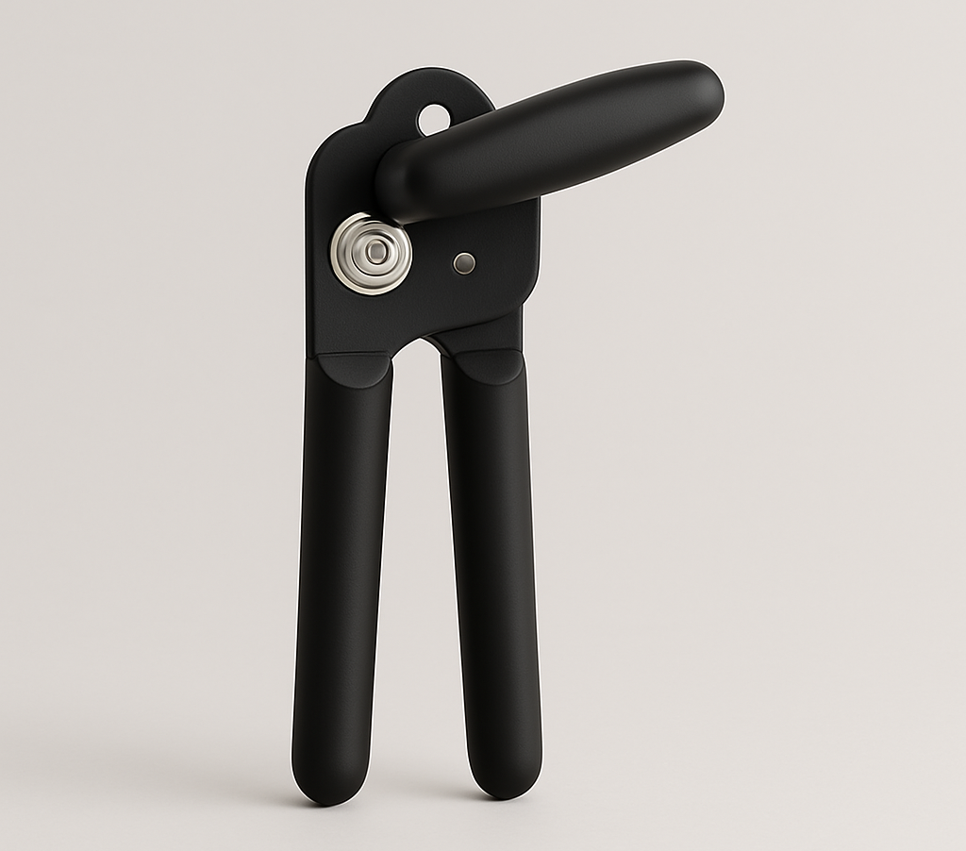
{{TITLE}}
{{DESCRIPTION}}
Notes:
--- This slide focuses on articulating the product’s core purpose and unique value that addresses a real problem or need in the market. Image source: Microsoft 365 content library

